Slide 1
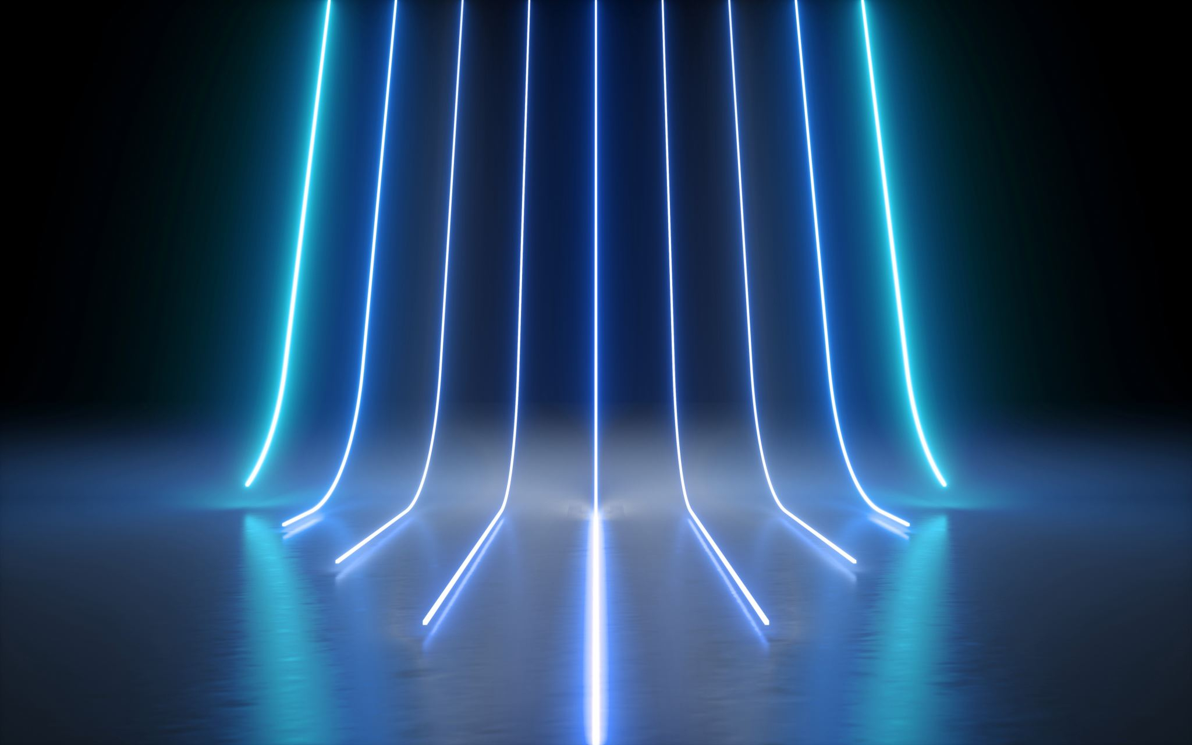
Topic Discussion
Bavithra Lakshmanasamy

Slide 2
UW-Madison GI tract Image segmentation Objective: Segment both partial and unseen cases https://www.kaggle.com/competitions/uw-madison-gi-tract-image-segmentation/overview
Description: use ML to automatically segment the stomach and intestines on MRI scans.
Source: Kaggle
Data:
data point- MRI scans
Type- 16-bit grayscale PNG format
size- 2.47 GB.
Problem/task:
The task is to perform pixel segmentation.
Metric: Dice coefficient and 3D Hausdorff distance
Resources: Kaggle

Slide 3
Driver Drowsiness Detection System with Neural networks Objective: build a drowsiness detection system that will detect that a person’s eyes are closed for a few seconds. https://data-flair.training/blogs/python-project-driver-drowsiness-detection-system
Description: Drowsiness detection system, build a model using deep neural network to classify images and detect if that person’s eyes are closed for a few seconds or not
Source: Data flair. Training
Data:
Data point: images with varied eye patterns like yawning, closed, opened.
Instances: 2900 images in total which are 145x145 and the format is of .jpg
Size: 169MB
Task: Classification (Classifier will categorize whether eyes are open or closed)
Metric: Accuracy
Resource: https://drive.google.com/file/d/1zodAMJQFuqThN3sKQ9Bcb76gUSFIMPrG/view?pli=1

Slide 4
Hotel-ID to combat human trafficking Objective: Build models that can overcome this extra layer of difficulty https://www.kaggle.com/competitions/hotel-id-to-combat-human-trafficking-2022-fgvc9/overview
Description: identify the hotel seen in test images from the TraffickCam dataset, which are based on a large gallery of training images with known hotel IDs.
Source: Kaggle
Data type: Images- jpg, png, csv
Size : 15.38 GB
Metric: Submissions are evaluated according to the Mean Average Precision
Resources: Kaggle

